Slide 1






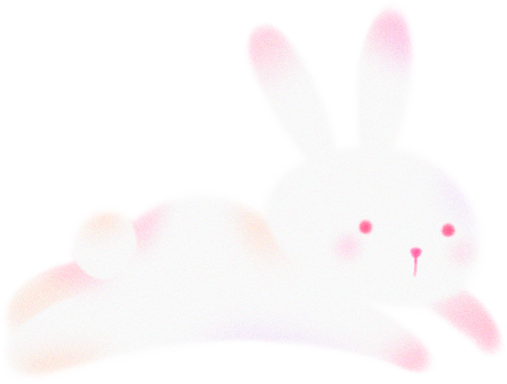
Porfolio
THÙY DƯƠNG

Slide 2


Introduction
My focus is on applying technological knowledge to create innovative design solutions. I have experience with 2D design tools and am actively honing my skills in Motion Graphics to create engaging and effective animated products. My goal is to participate in meaningful projects where I can contribute, grow, and develop into a versatile designer.

Slide 3

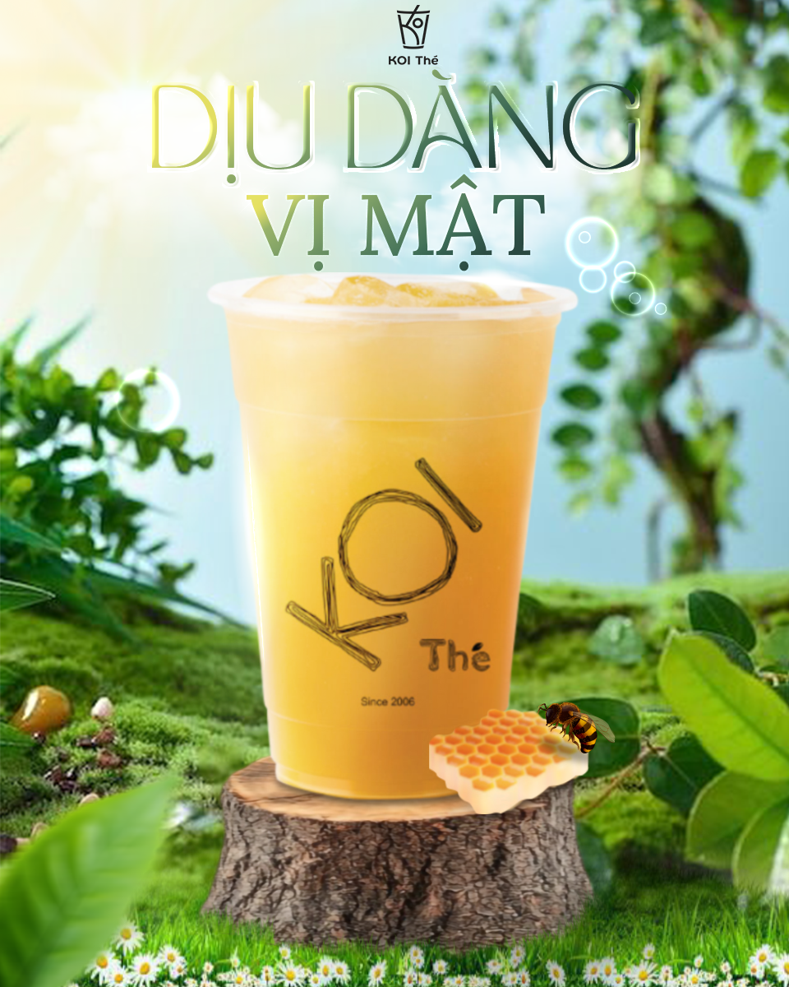

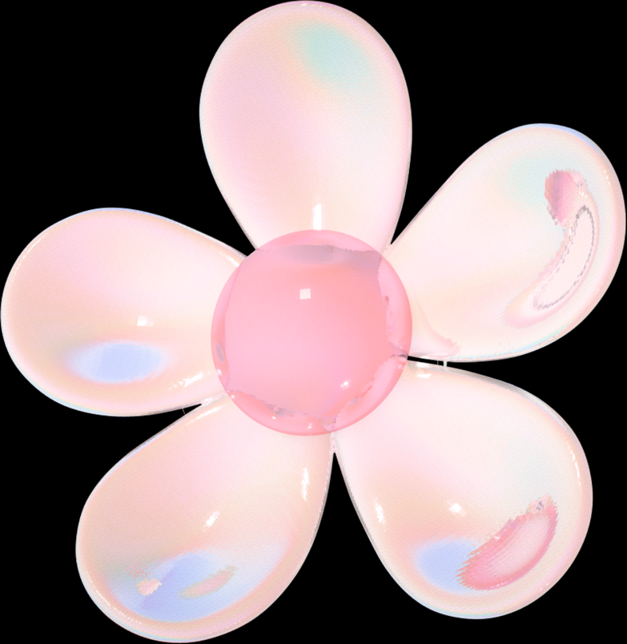
Project Overview
2D - GRAPHIC
This is a personal, conceptual project aimed at designing a promotional poster for a new drink from the popular bubble tea brand, KOI Thé. The project introduces a refreshing honey-flavored green tea, targeting young consumers who appreciate natural and soothing flavors.

Slide 4
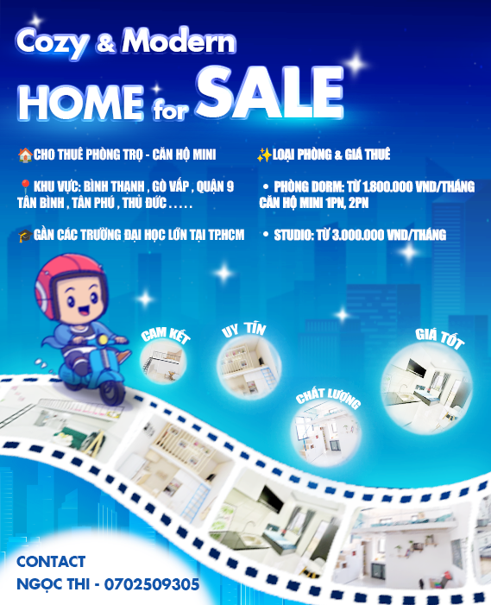
Project Overview
2D - GRAPHIC
This is a personal, conceptual project aimed at designing a promotional poster for a new drink from the popular bubble tea brand, KOI Thé. The project introduces a refreshing honey-flavored green tea, targeting young consumers who appreciate natural and soothing flavors.

Slide 5

Project Overview
2D - GRAPHIC
This project is a promotional banner designed for a "Super Sale" event for a line of natural skincare products. The main objective was to create a vibrant and eye-catching graphic suitable for social media marketing and e-commerce websites to drive customer engagement and boost sales during the promotional period.

Slide 6
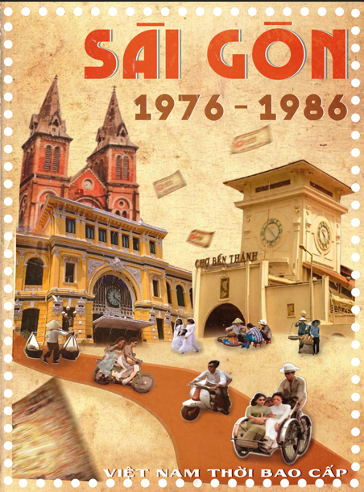

Project Overview
2D - GRAPHIC
This is a personal creative project that pays tribute to the city of Saigon (now Ho Chi Minh City) during the historic "Bao Cấp" (Subsidy) period. The goal was to design a poster that evokes a deep sense of nostalgia, capturing the unique visual aesthetic and atmosphere of Vietnam from 1976 to 1986.

Slide 7

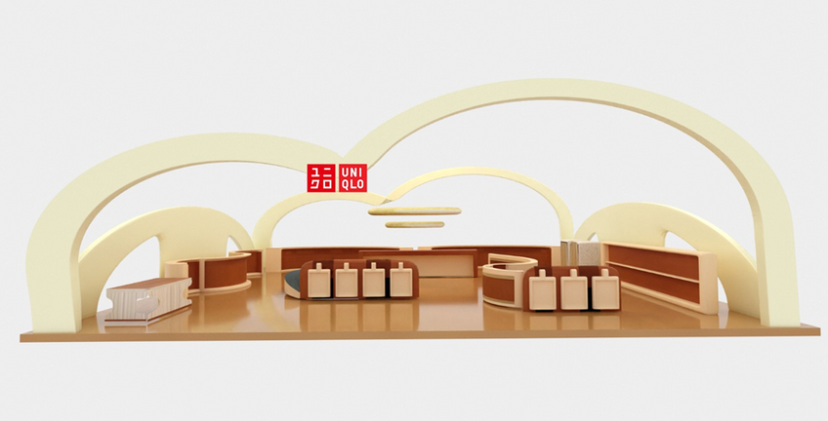
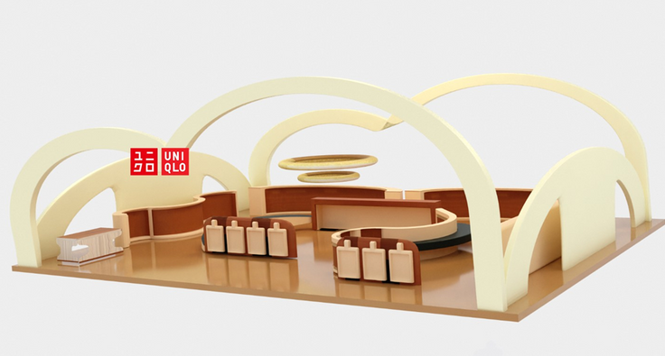
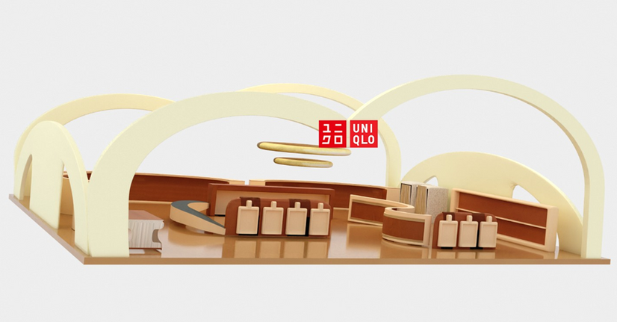
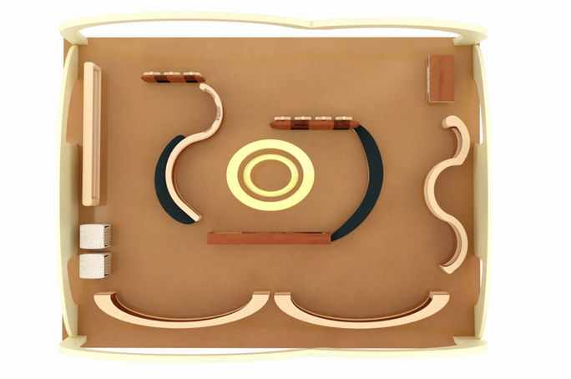
Project 3D

Slide 8
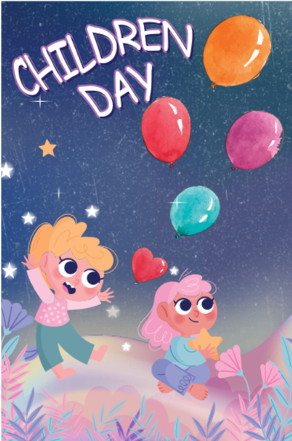

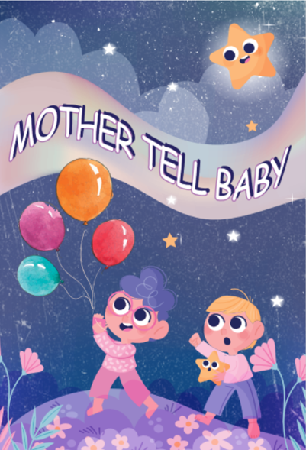


Project Posdcard

Slide 9
Thank
You
www.reallygreatsite.com
-
hello@reallygreatsite.com

